Slide 1
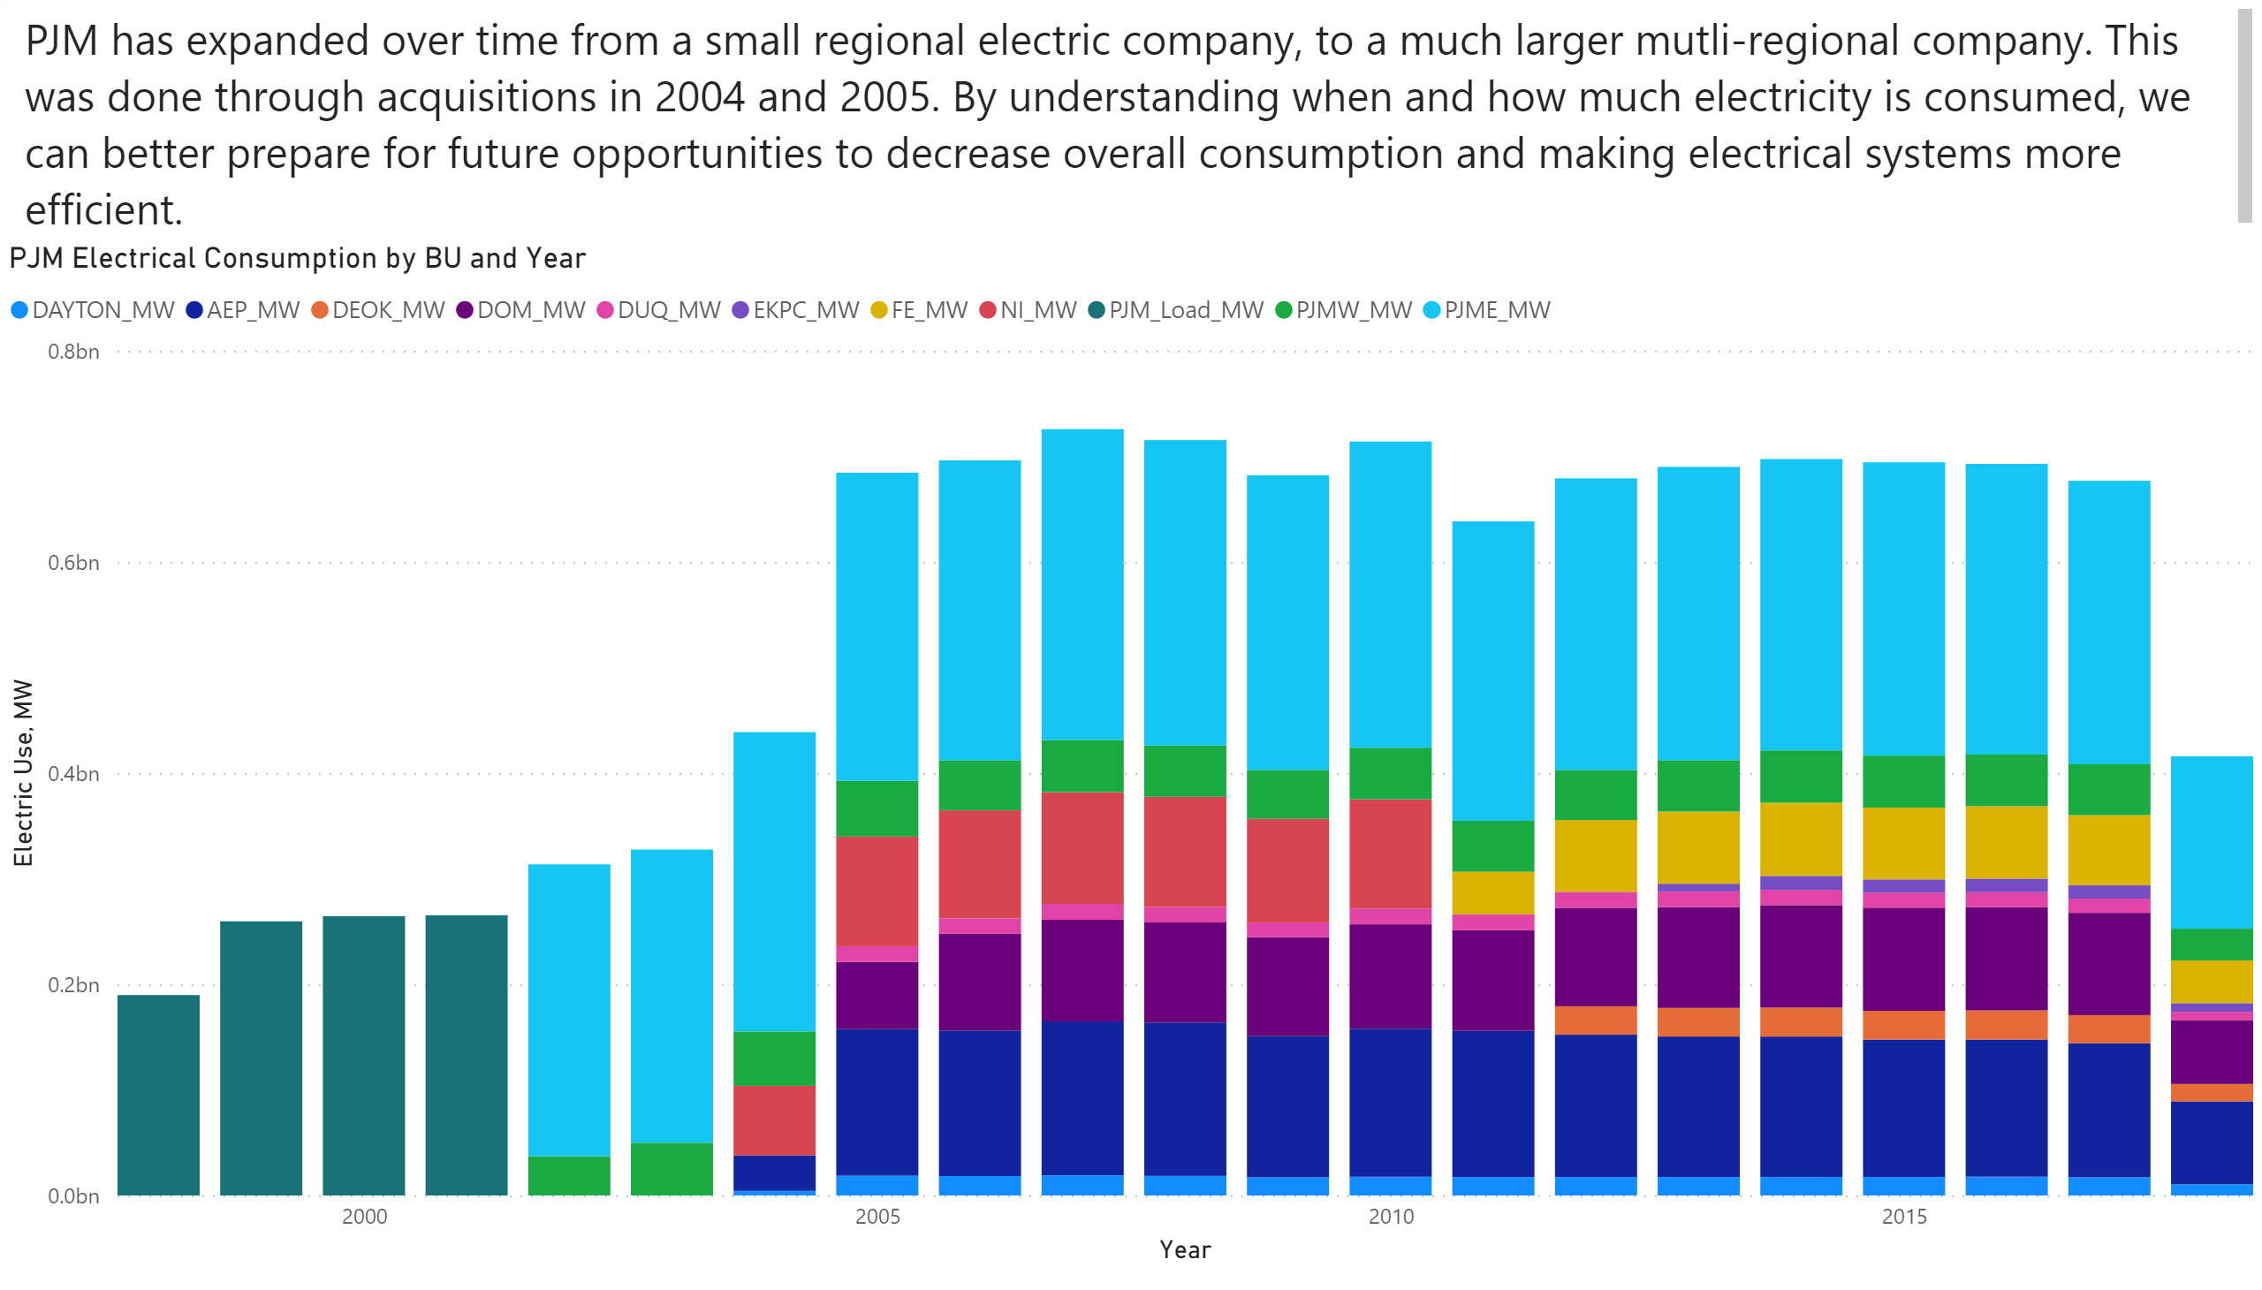
Total Consumption over Time by BU
Notes:
PJM Electrical Consumption by BU and Year
PJM Electrical Consumption by BU and Year
textbox
No alt text provided.

Slide 2
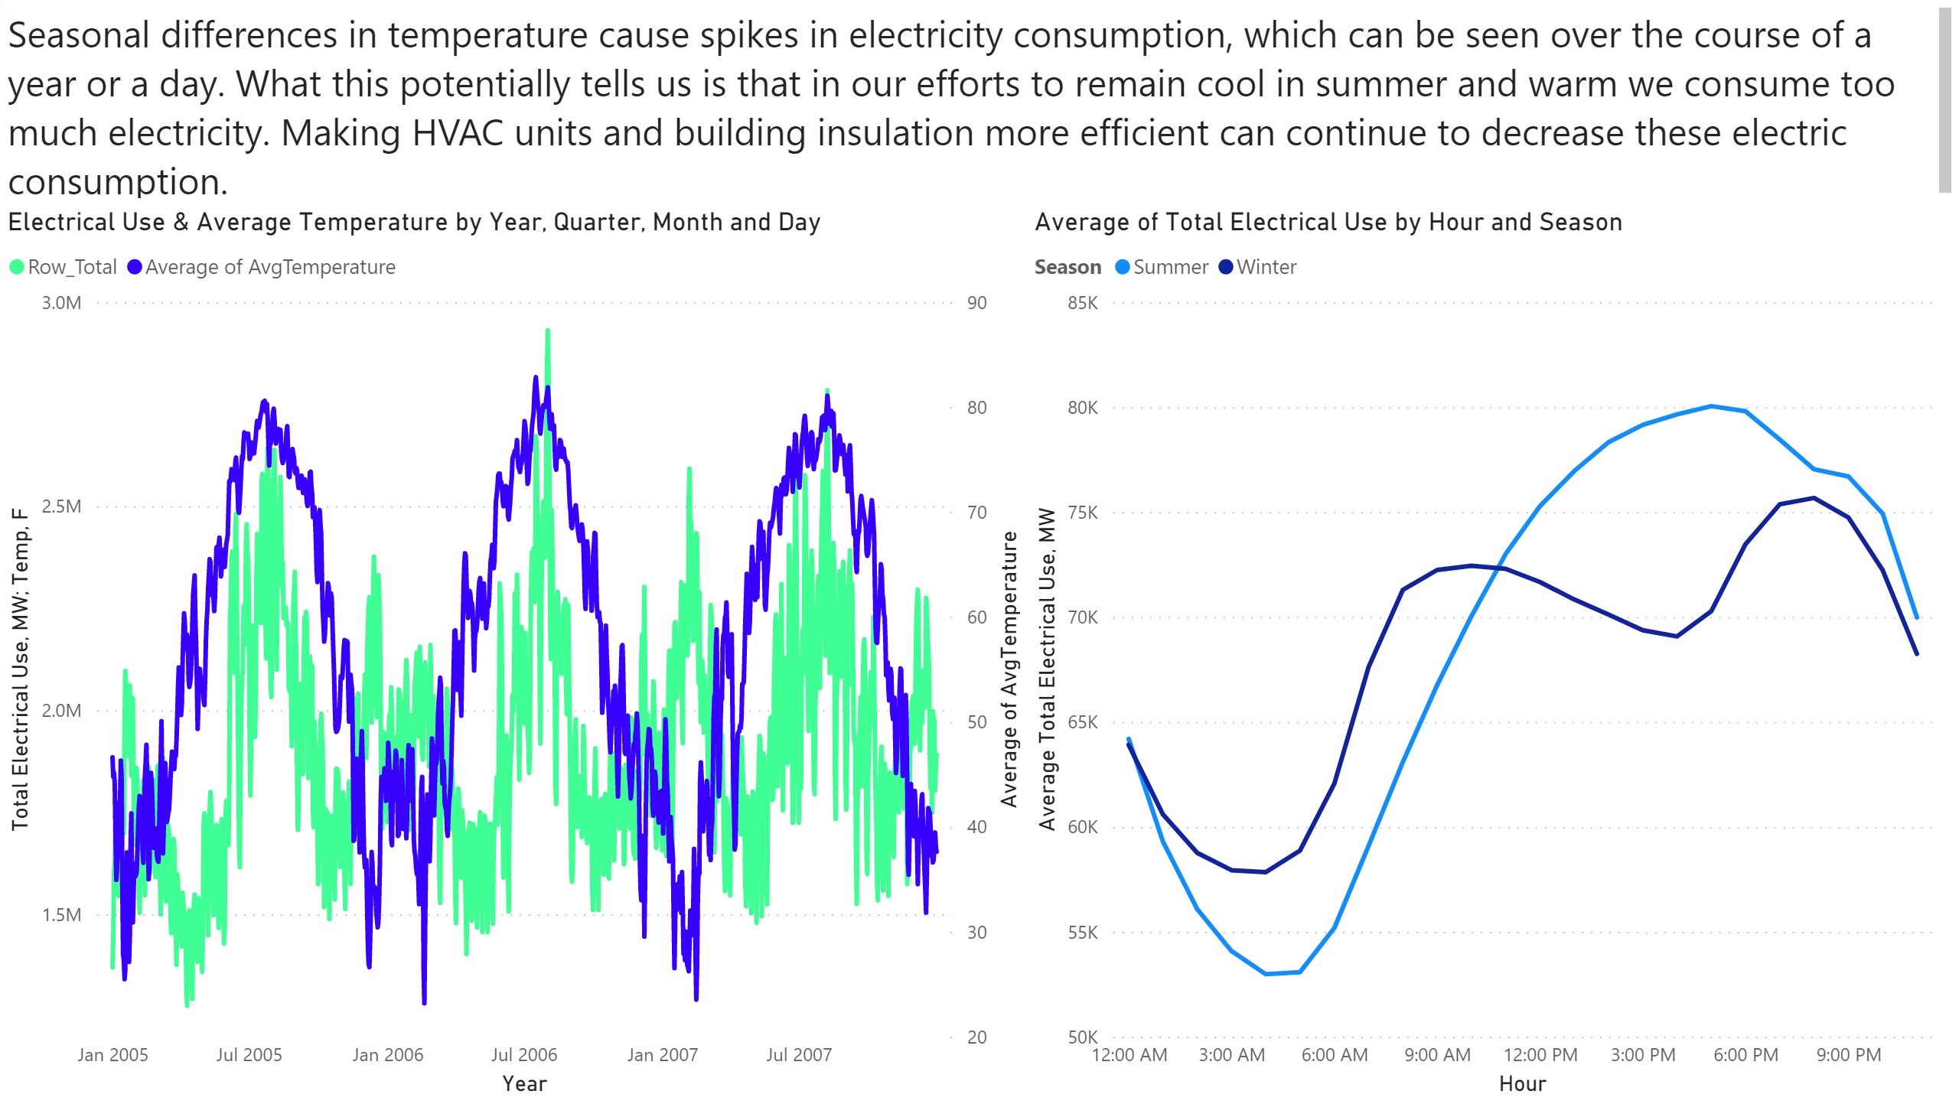
Consumption over Time
Notes:
Electrical Use & Average Temperature by Year, Quarter, Month and Day
No alt text provided.
textbox
No alt text provided.
Average of Total Electrical Use by Hour and Season
No alt text provided.

Slide 3
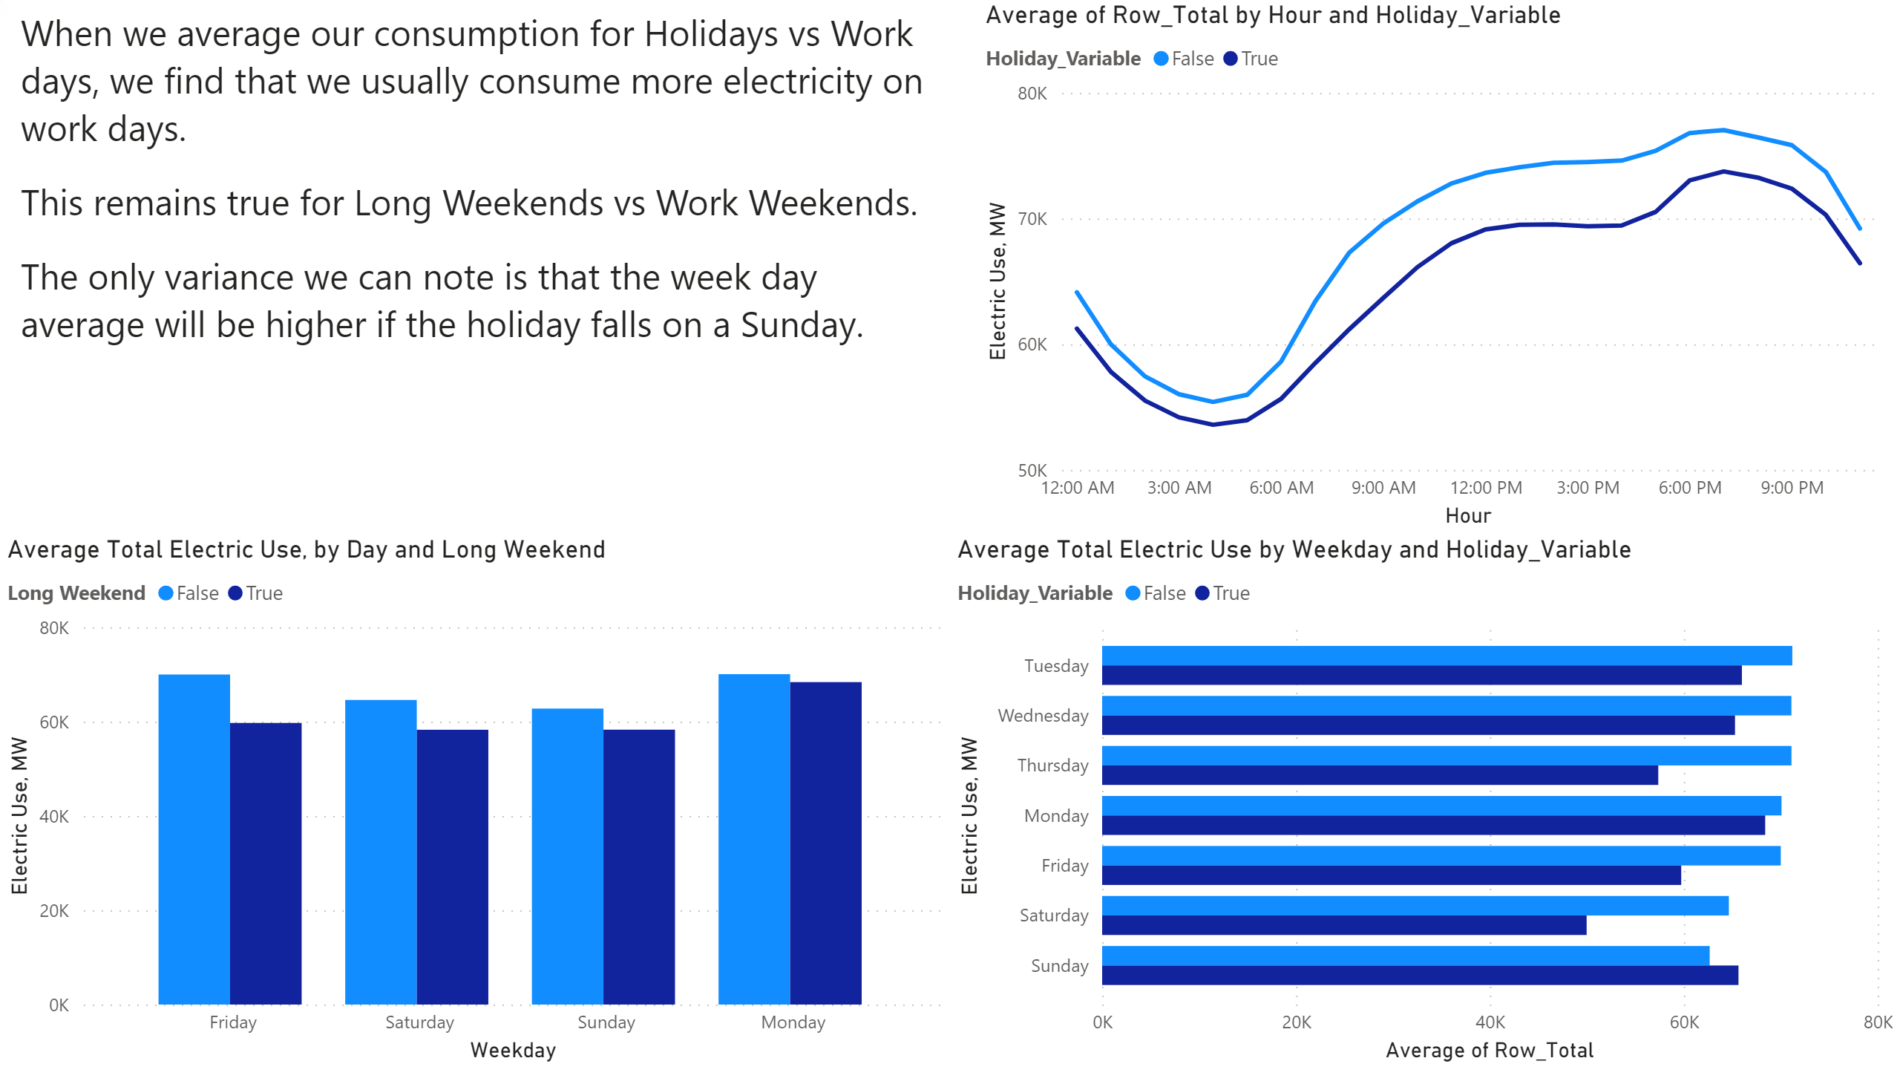
Work Days
Notes:
textbox
No alt text provided.
lineChart
No alt text provided.
Average Total Electric Use by Weekday and Holiday_Variable
No alt text provided.
Average Total Electric Use, by Day and Long Weekend
No alt text provided.

Slide 4
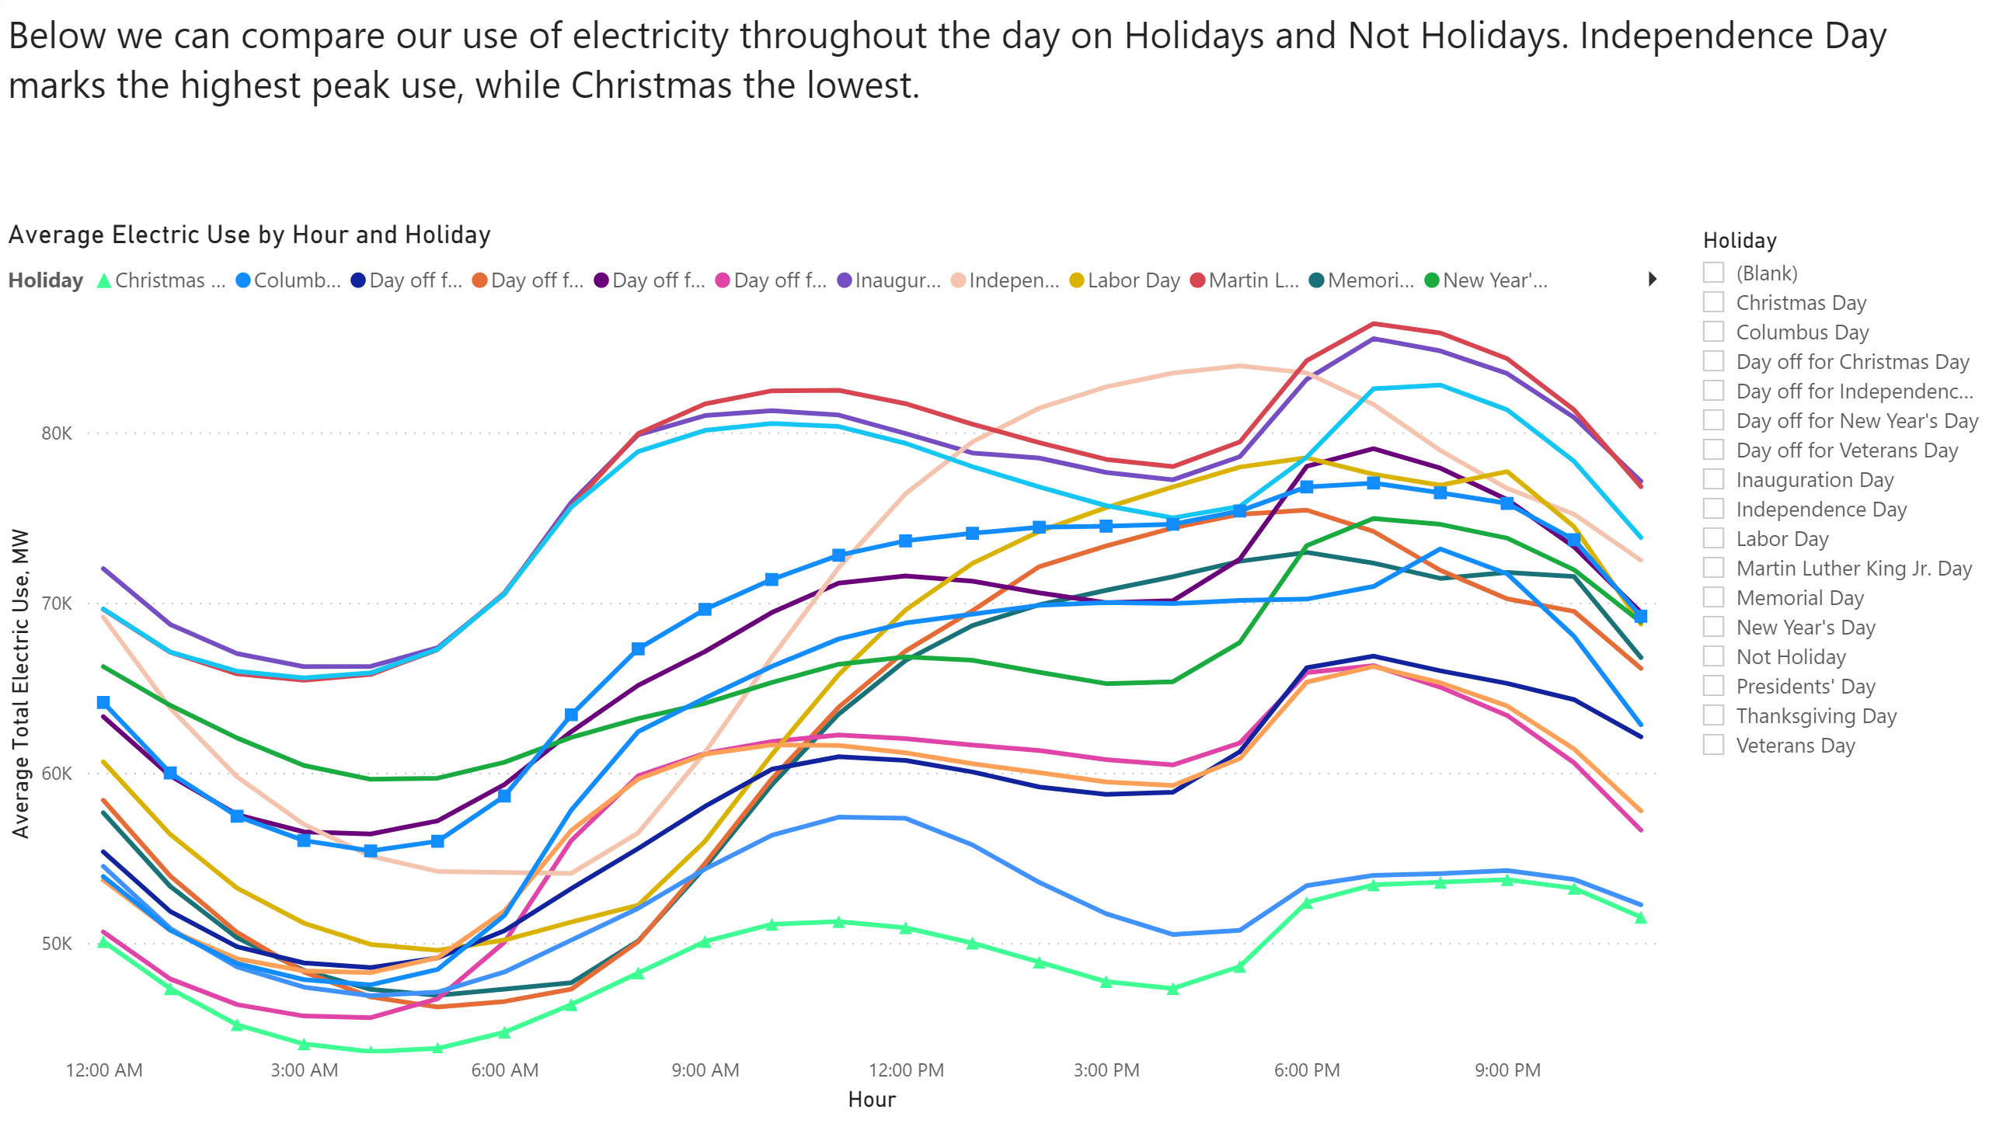
Average by hour and holiday
Notes:
Average Electric Use by Hour and Holiday
No alt text provided.
textbox
No alt text provided.
slicer
No alt text provided.

Slide 5
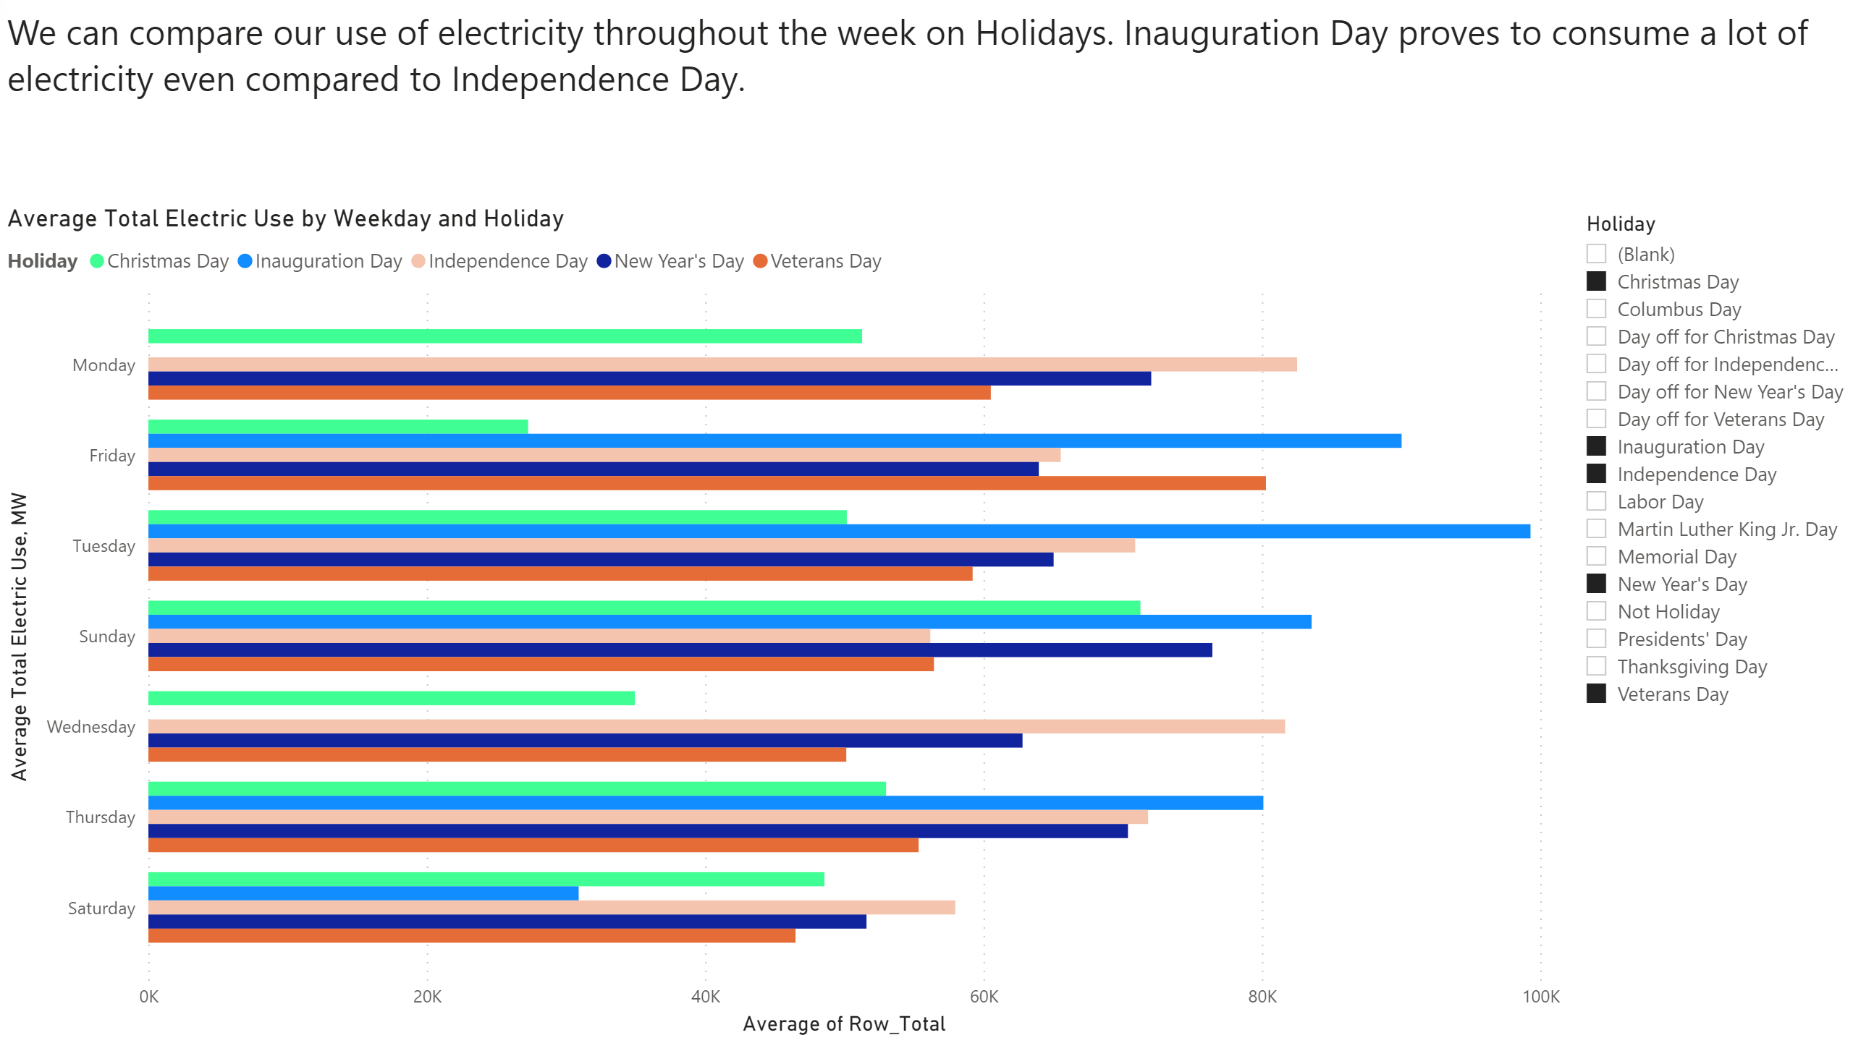
Average by Weekday and holiday
Notes:
Average Total Electric Use by Weekday and Holiday
No alt text provided.
textbox
No alt text provided.
slicer
No alt text provided.

Slide 6
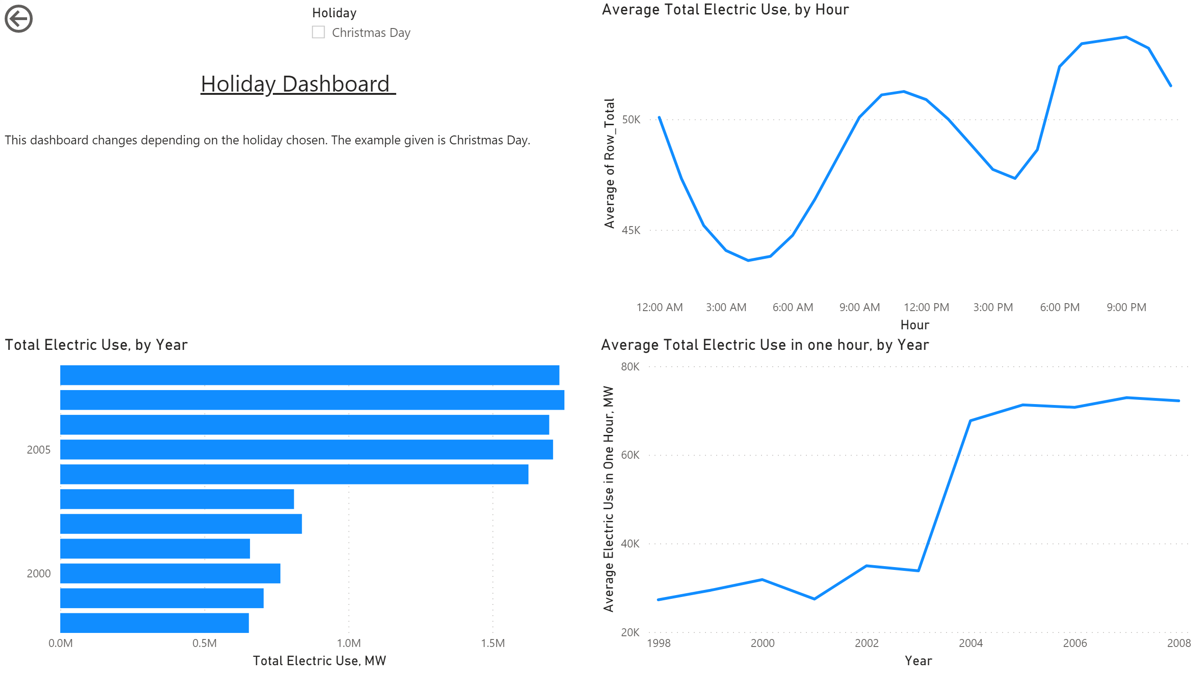
Holiday
Notes:
textbox
No alt text provided.
Average Total Electric Use, by Hour
No alt text provided.
Average Total Electric Use in one hour, by Year
No alt text provided.
Total Electric Use, by Year
No alt text provided.
slicer
No alt text provided.
actionButton
No alt text provided.

Slide 7
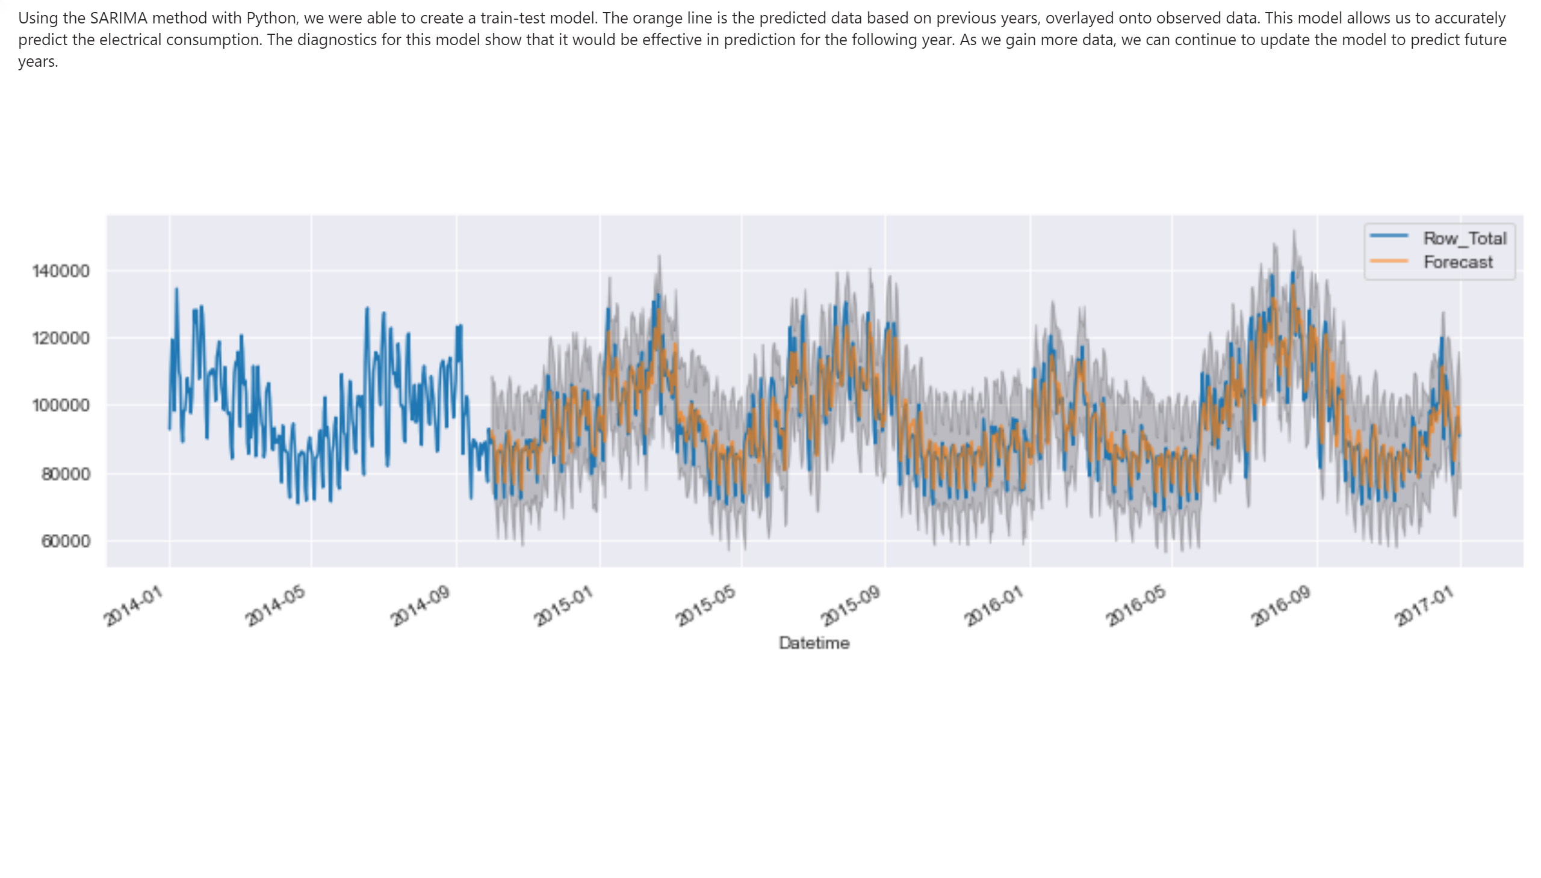
Model
Notes:
textbox
No alt text provided.
image
No alt text provided.

